Slide 1

Aircraft Crash Analysis Using Power BI
Internship Project By Shahriar Alam With Mentorness
BATCH –MIP-DA-06

Slide 2
OBJECTIVE
1.Temporal Analysis
2. Geospatial Analysis
3. Operator Performance
4. Aircraft Analysis
5. Fatality Trends
6. Route Analysis

Slide 3
Dataset Description:
1. Date: Date of the airplane crash.
2. Time: Time of the airplane crash.
3. Location: Location where the airplane crash occurred.
4. Operator: Operator or airline involved in the incident.
5.Flight: Flight number associated with the incident.
6. Route: Planned route of the flight.
7. AC Type: Aircraft type involved in the crash
8. Registration: Registration details of the aircraft.
9. cn/ln: Construction or serial number of the aircraft.
10. Aboard: Total number of individuals aboard the aircraft.
11. Aboard Passengers: Number of passengers aboard the aircraft.
12. Aboard Crew: Number of crew members aboard the aircraft.
13. Fatalities: Total fatalities in the incident.
14. Fatalities Passengers: Number of passenger fatalities.
15. Fatalities Crew: Number of crew member fatalities.
16. Ground: Casualties on the ground, if any.
17. Summary: Brief summary or description of the incident.

Slide 4
OBJECTIVE
1.Temporal Analysis
2. Geospatial Analysis
3. Operator Performance
4. Aircraft Analysis
5. Fatality Trends
6. Route Analysis

Slide 5
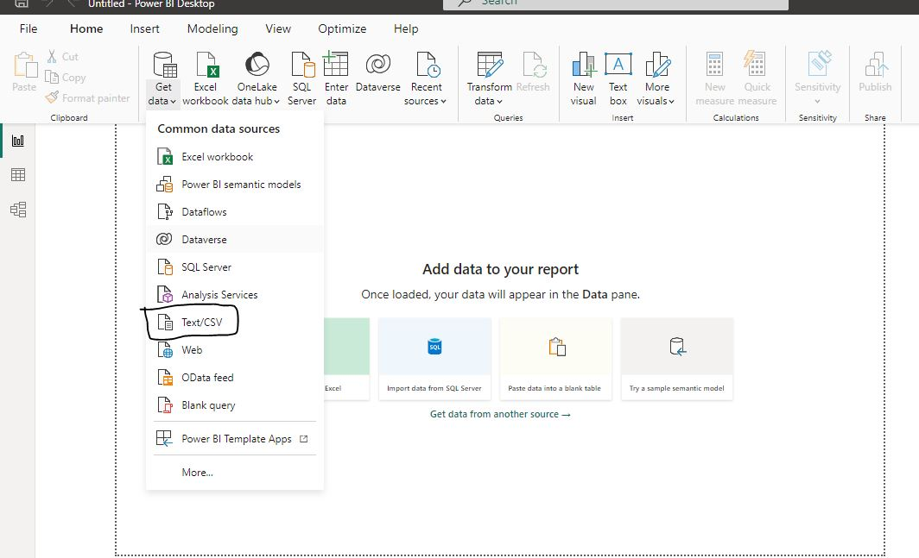
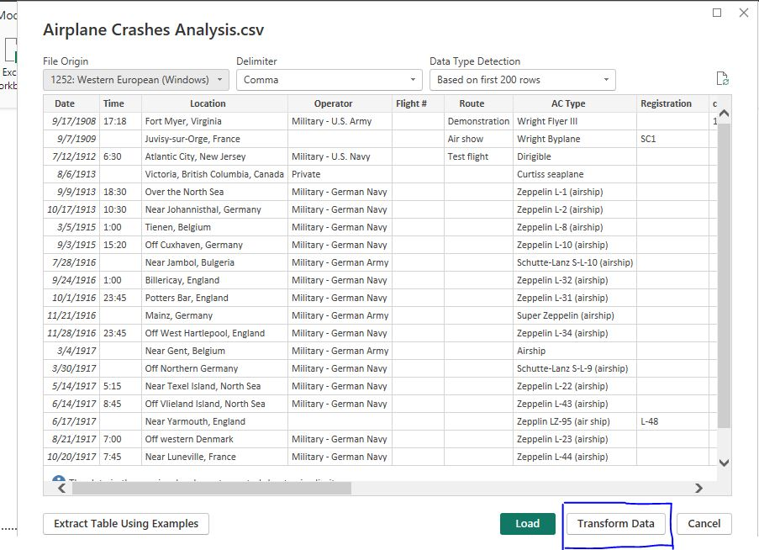
Import And Transform Data

Slide 6
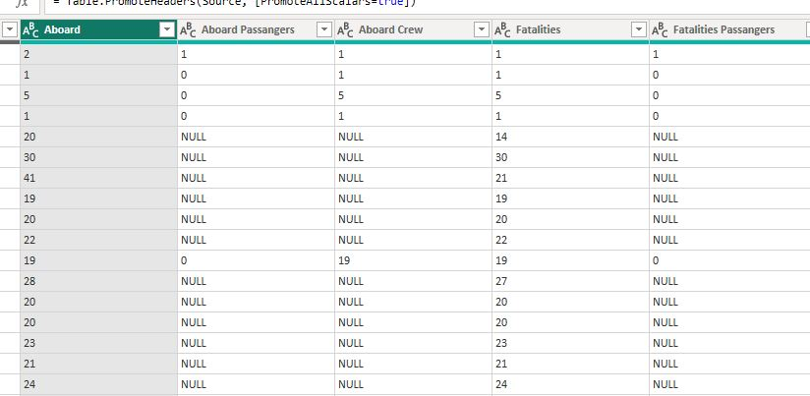
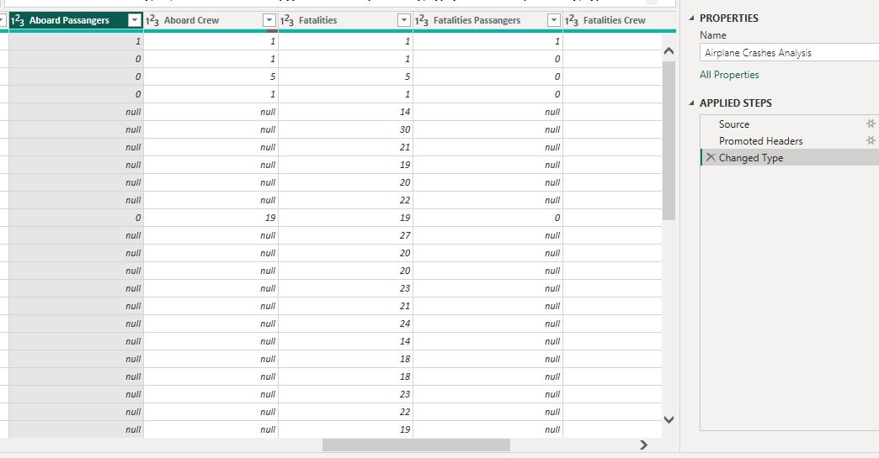
Detect Data Type And Change Some Column Data Type

Slide 7
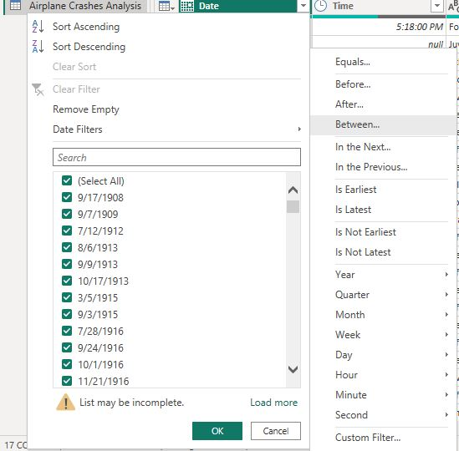
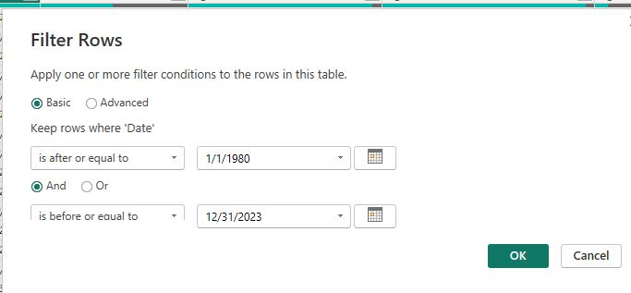
Date Column Filtering(1980 to 2023)

Slide 8
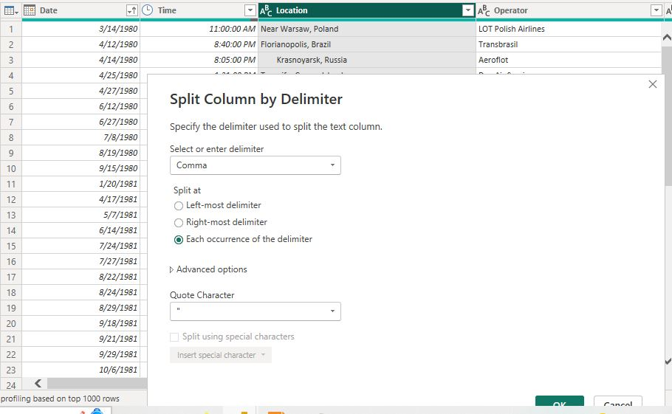
Split Location Column By Delimiter

Slide 9
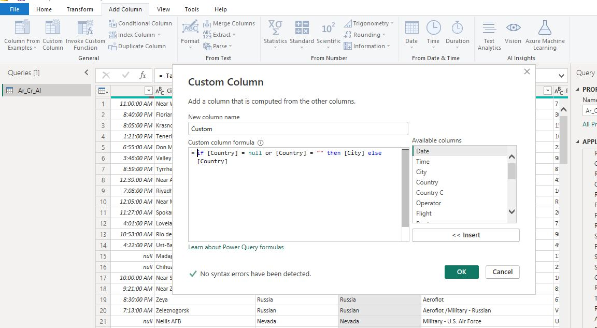
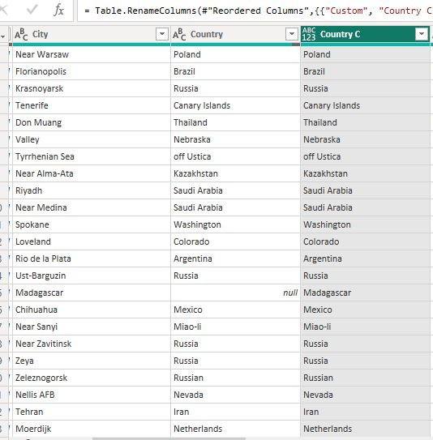
Custom Country Column

Slide 10
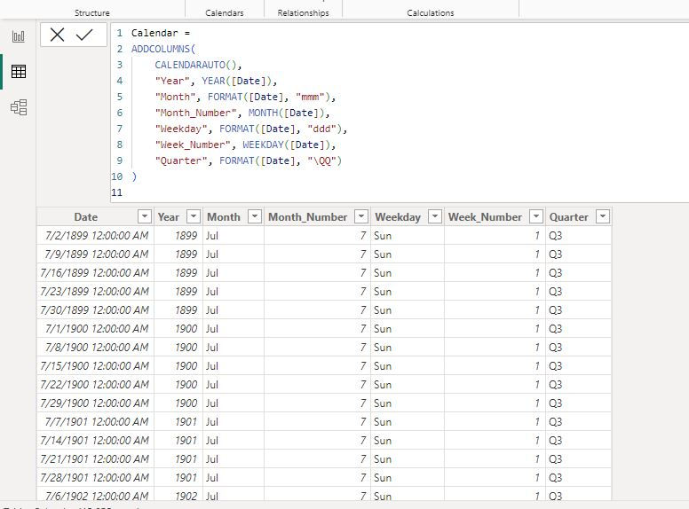
Create Date Table

Slide 11
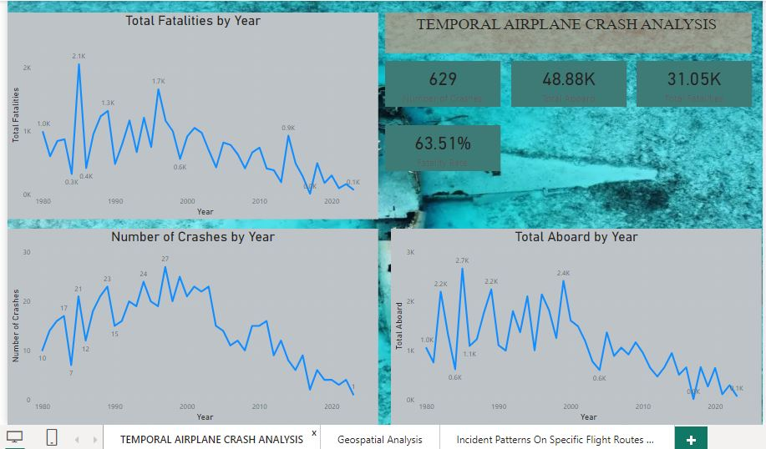
Temporal Aircraft Crash Analysis Over Years

Slide 12
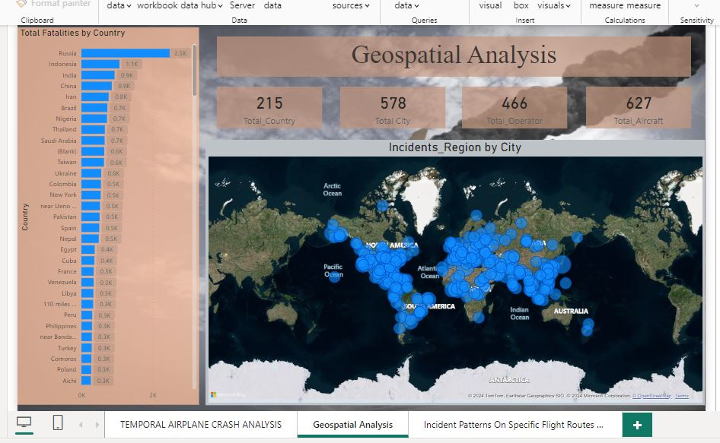
Temporal Aircraft Crash Analysis Over Years

Slide 13
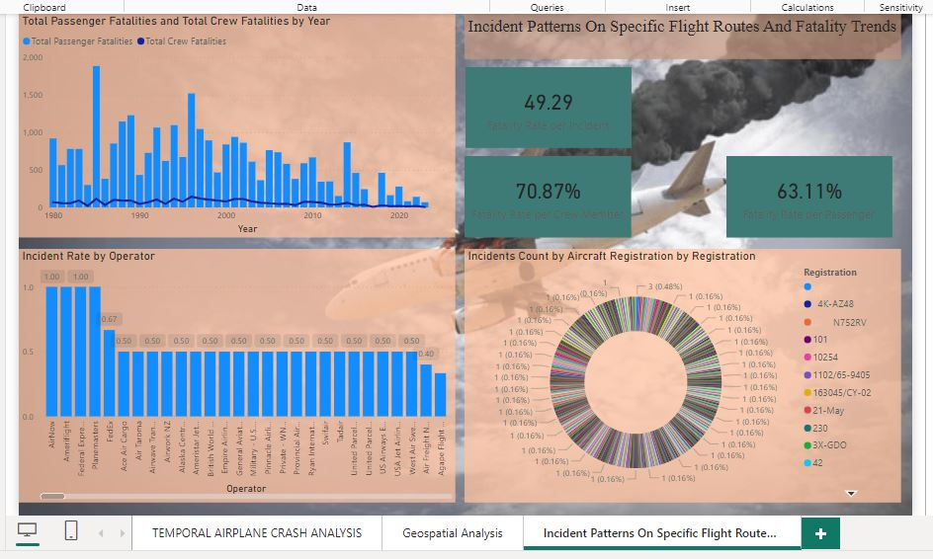
Temporal Aircraft Crash Analysis Over Years

Slide 14
CONCLUSION
In Power BI, I can use Power Query to transform my data, including scenarios where I need to handle null or blank values in a column. By adding a custom column with an if...then...else logic, I can ensure that the country name equals the city name when the country name is null or blank. This approach helps ensure consistency in my data and prepares it for further analysis and visualization in Power BI.

Slide 15
THANK YOU

